Slide 1
Quantum Technology
An iPOL by Sierra Rose

Slide 2
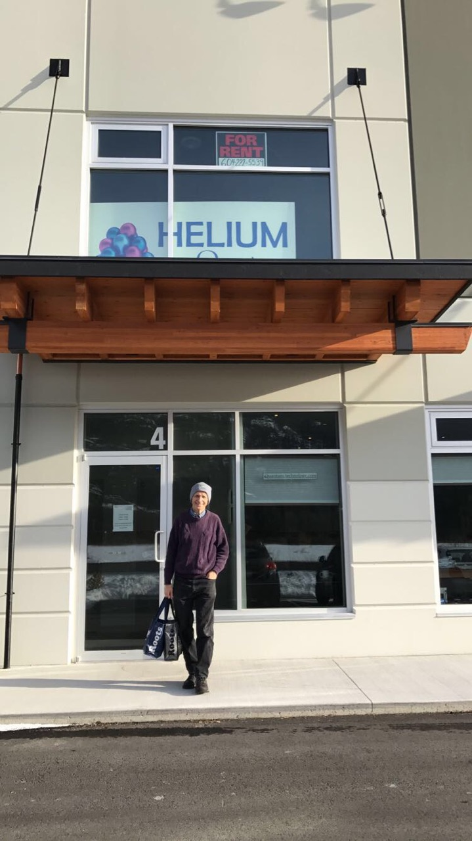
How Can I Help?
Important words to live by in any work environment
I would go from person to person and every day as them if there was anything I could help them with at least once a day
Taught to me by Calvin Winter, my mentor.

Slide 3
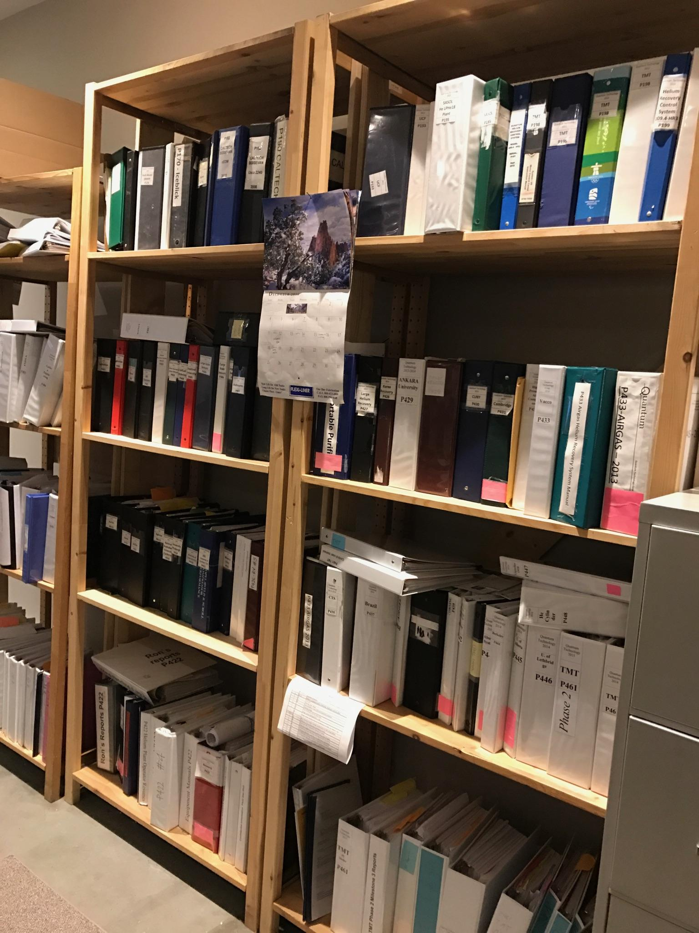
My Education
I got to learn what an active work environment is like - an experience I could not learn at school.

Slide 4
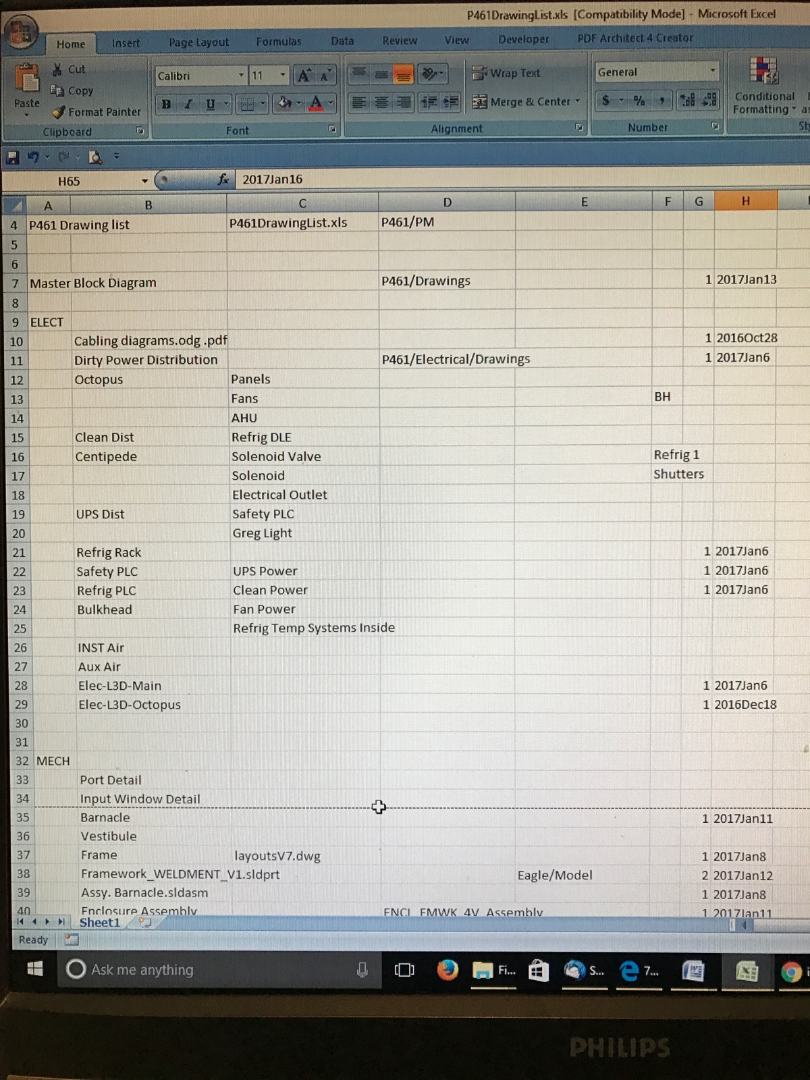
How Is My Work Significant?
I was able to move progress forward in the project by compiling several excel spreadsheets - most importantly a spreadsheet that holds all the dates and locations of working documents.
This was my project.

Slide 5
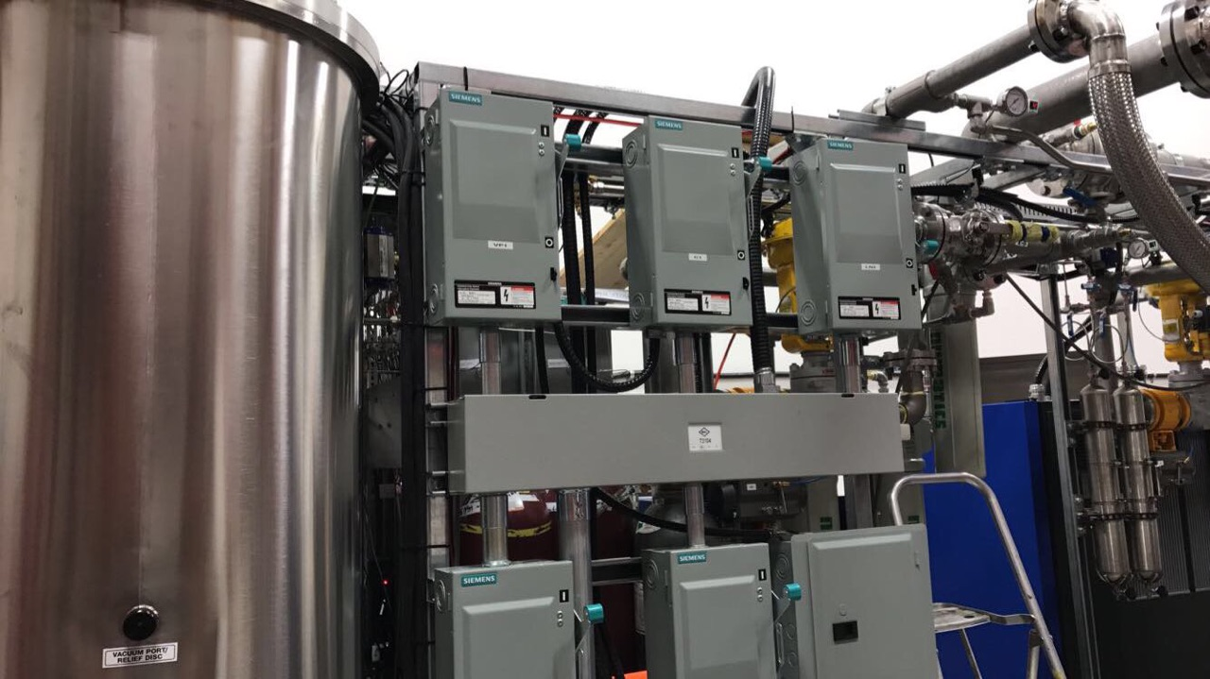
F I N D Y O U R S E L F
I am not a person who can sit at a desk all day.
This was important for me because it made me reevaluate what I want to do in my life.
But that subject can wait.

Slide 6
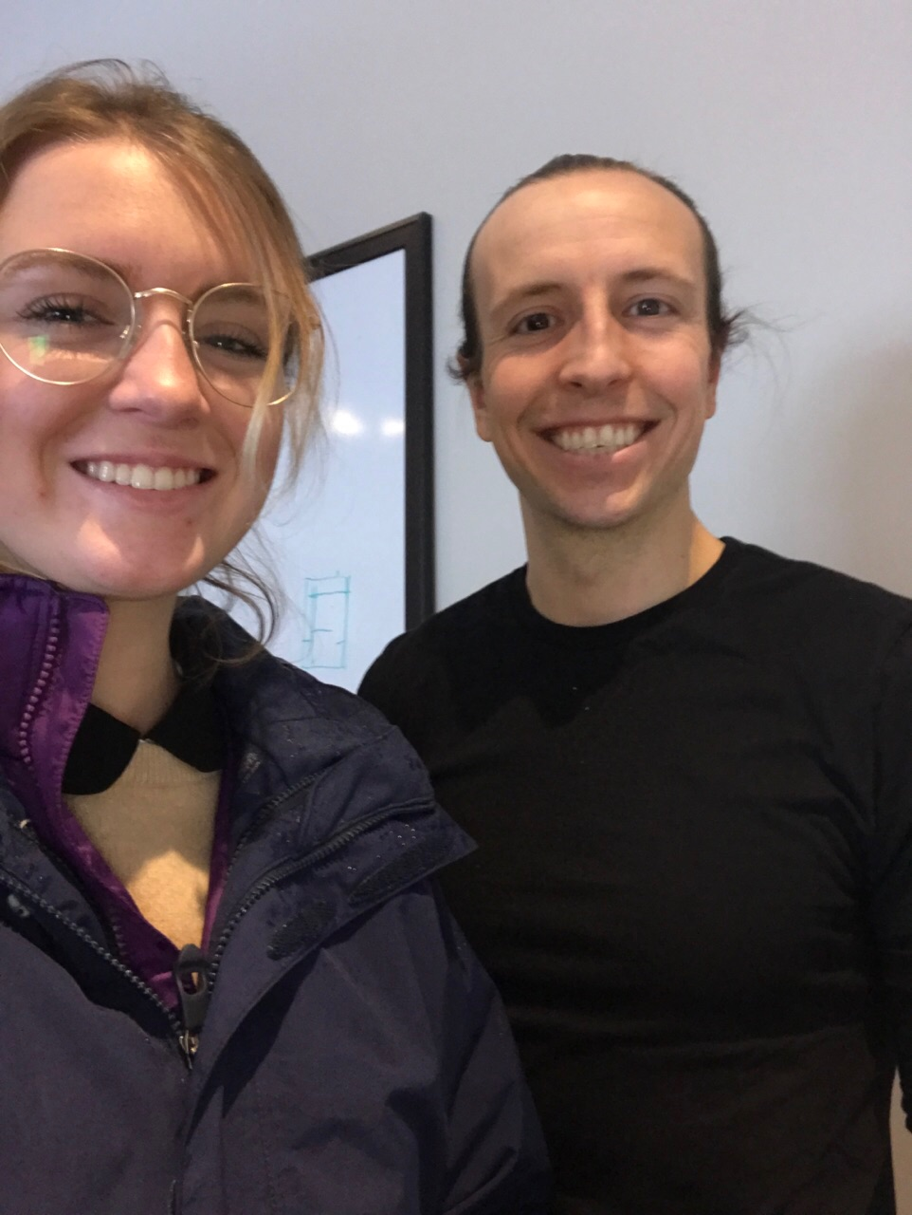
What’s Gonna Work?
Teamwork.
I learned that communication is a vital part of the work force.
Even if you have great ideas, it does no good to anyone if you can’t communicate those ideas to other people.
A picture of Adam, a co-worker

Slide 7
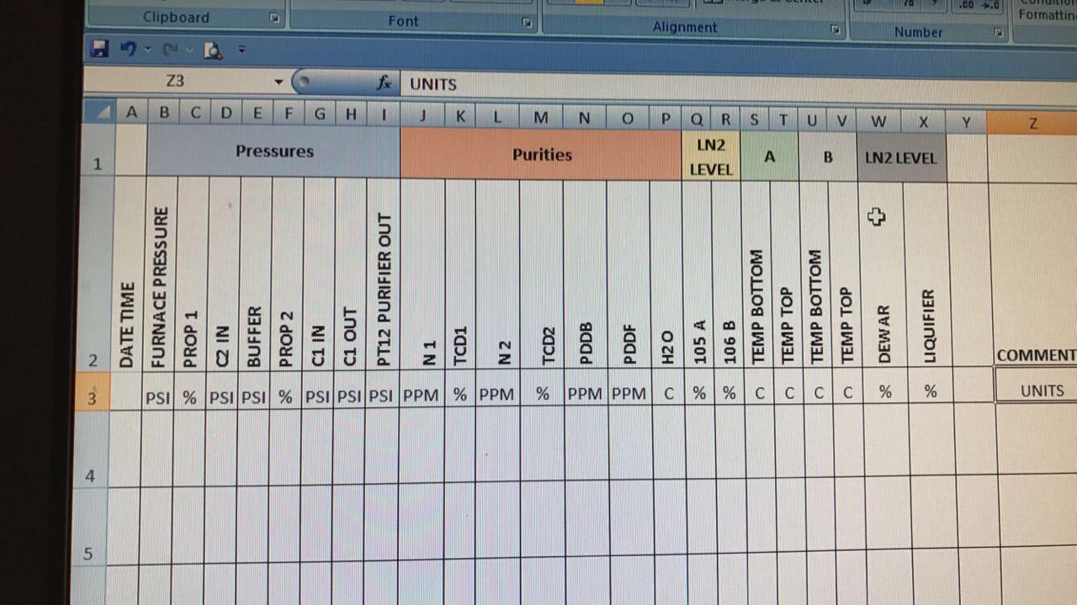
Desk Jockey Appreciation
It is hard work. I once thought it was easy...
But microsoft excel taught me otherwise

Slide 8
Every Snowflake Is Different
Just like you and each and every one of my co workers.
Yet despite big differences, we all were able to collaborate.

Slide 9
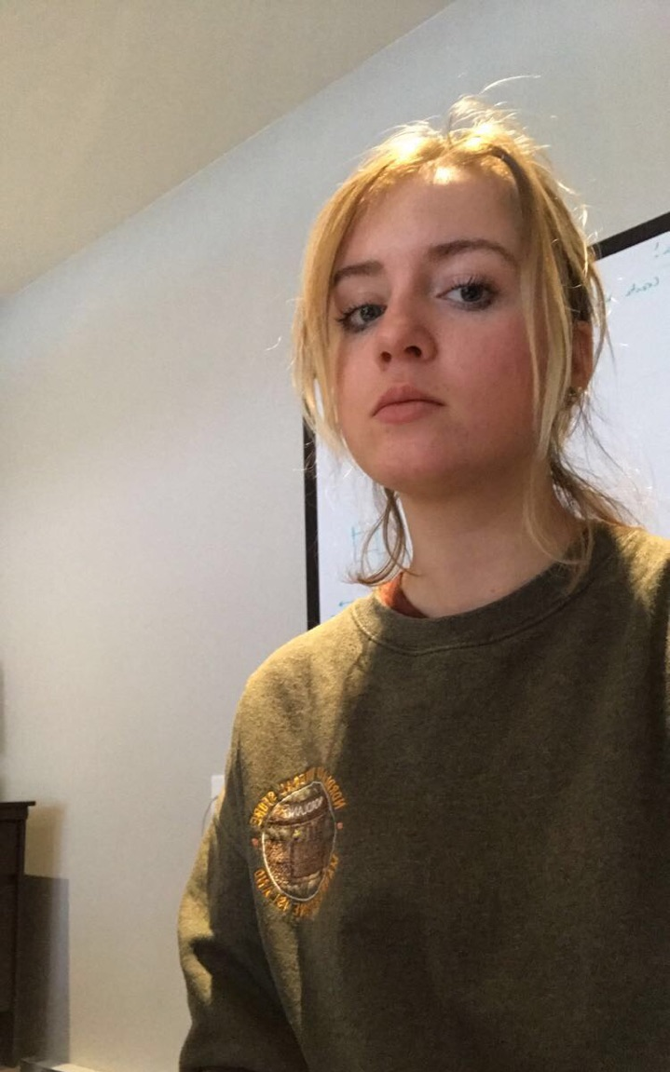
What Does This Mean For The Future?
I will not work at a desk.
Maybe I will start a small business like Dr.Winter
Or become a hairstylist or a barista.
It has really changed my perspective on business.

Slide 10
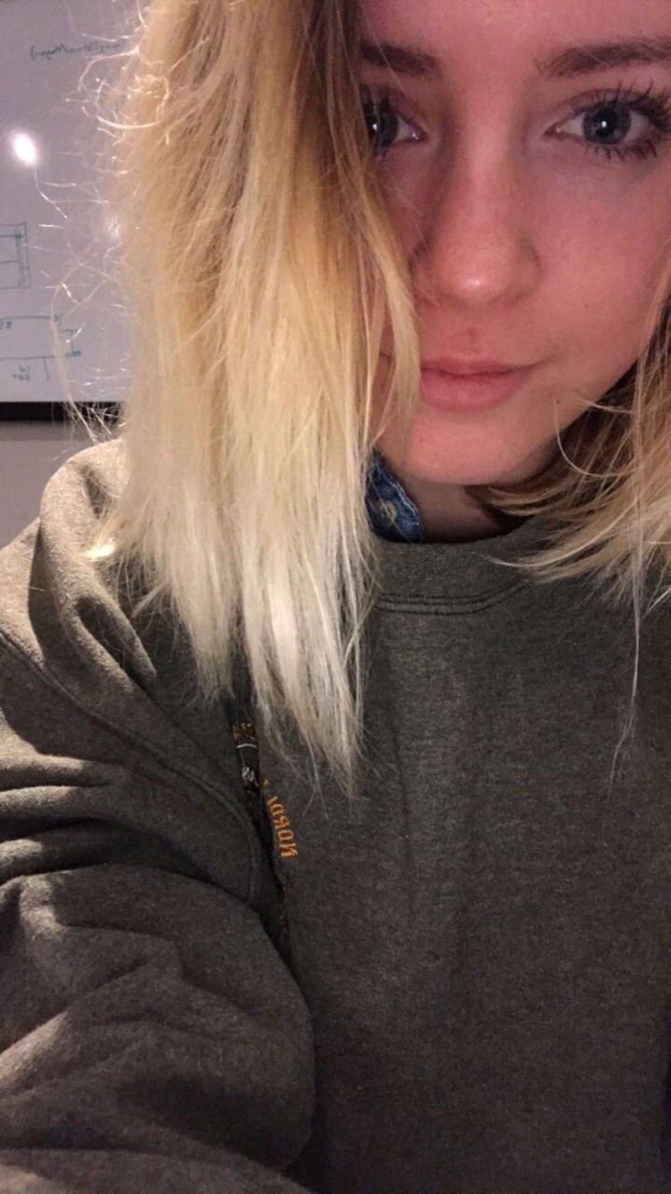
So … What Did I Learn?
Communication is Key
Ask more and more questions until you understand
“How Can I Help?”
Smile :)

